Slide 1
MCA Final Year Project (Review II) Rebil
Submitted to the Presidency University, Bengaluru in partial fulfilment for the award of the degree of Master of Computer Applications(MCA)
Project Number : MCA_PR216
Under the supervision of
Mr. Sakthi S Asst.Prof-SCSE Presidency University
Name | Roll Number
DEEPAK KUMAR SINGH D | 20232MCA0198

Slide 2
Content
Abstract
Problem Statement
Literature Survey
Tools and Technologies to be used
Modules
Screenshots
References
Github Link

Slide 3
Abstract
Web-Based HR Platform: Built with HTML, CSS, Bootstrap and PHP to streamline HR and admin tasks.
Recruitment Management: Includes an Applicant Tracking System (ATS) for handling applications, interviews and offers.
Document Handling: Allows secure upload, organized storage and quick search of HR documents.
Compliance Tracking: Ensures hiring processes follow company policies and industry standards.
Future Plans: Will add AI-based analytics for better candidate insights and cloud storage for improved security and scalability.

Slide 4
Problem Statement
Many HR departments struggle with managing recruitment, documents and compliance due to the lack of a unified system.
Tracking candidates manually through the hiring process leads to inefficiencies and disorganization.
Storing and retrieving HR documents can be slow and insecure without a proper digital solution.
Ensuring that hiring practices follow company policies and legal standards is challenging without compliance tracking tools.
Current systems often lack scalability, security and advanced features like AI-driven analytics for better decision making.

Slide 5
Literature Review
SL NO | Title of the Paper | Year | Methodology Used | Challenges Faced | Advantages | Disadvantages
1 | AI-Driven HR Management Systems for Efficient Recruitment | 2020 | Machine Learning Algorithms for Resume Screening and Candidate Matching | Data Privacy Concerns | Faster and Accurate Candidate Selection | Bias in AI Models
2 | Integrating HR Software with Social Media Platforms for Talent Acquisition | 2020 | Social Media Data Mining for Candidate Profiling | Data Authenticity and Privacy Issues | Improved Talent Sourcing | Difficulty in Filtering Unqualified Candidates
3 | Cloud-Based HR Solutions for Enhanced Workforce Management | 2019 | Cloud Infrastructure with SaaS Integration | Integration with Legacy Systems | Easy Access and Cost-Effective Solution | Potential Security Risks

Slide 6
Literature Review
SL NO | Title of the Paper | Year | Methodology Used | Challenges Faced | Advantages | Disadvantages
4 | Blockchain Technology in Background Verification Systems | 2021 | Blockchain Ledger for Immutable BGV Records | High Implementation Cost | Enhanced Security and Tamper-Proof Records | Requires Advanced Technical Knowledge
5 | Enhancing Employee Engagement Using Gamification Techniques | 2022 | Gamified Platforms with Reward Mechanisms | Employee Fatigue with Over-Gamification | Improved Motivation and Productivity | Requires Continuous Content Updates
6 | Cloud-Based HR Solutions for Enhanced Workforce Management | 2021 | Real-Time Vendor Collaboration Portals | Vendor Data Management | Faster Closing of Positions | Increased Risk of Miscommunication

Slide 7
Module Design
User Authentication & Login
HR Community

Slide 8
Module Design
User Authentication & Login:
HR Login (Individual & Company)
BGV Company Login
Recruitment Login
Vendor Empanelment
Recruitment Management and HR Community:
Applicant Tracking System (ATS)
Recruitment Analytics & Reporting
Bench Candidate Availability Sharing
HR & Vendor Collaboration
Subscription-based Data Access

Slide 9
Tools And Technologies To Be Used
HARDWARE REQUIREMENTS:
Processor: AMD Ryzen 5 / Intel i5 or higher Hard Disk : 512 GB..
Hard Disk: Minimum 512 GB storage
Monitor: 15” LED display
Input Devices: Keyboard, Mouse
RAM: Minimum 4 GB (8 GB recommended for better performance)

Slide 10
Tools And Technologies To Be Used
SOFTWARE REQUIREMENTS:
Frontend: HTML, CSS, Bootstrap, JavaScript and jQuery
Backend: PHP and MySQL
Other Technologies:
Session management and authentication for secure login
Cloud storage integration (Future enhancement)
Encryption-based document handling (For secure BGV processing)

Slide 11
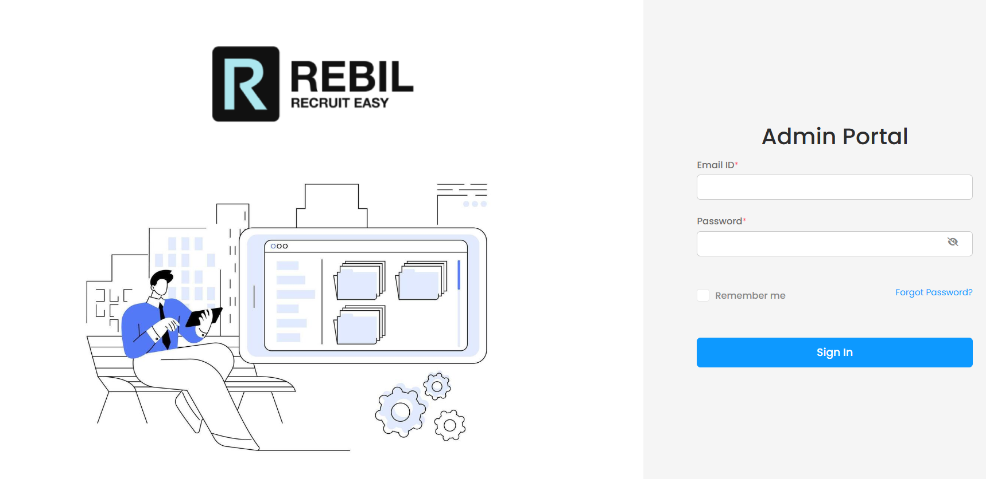
Screenshots
Admin Login Portal

Slide 12
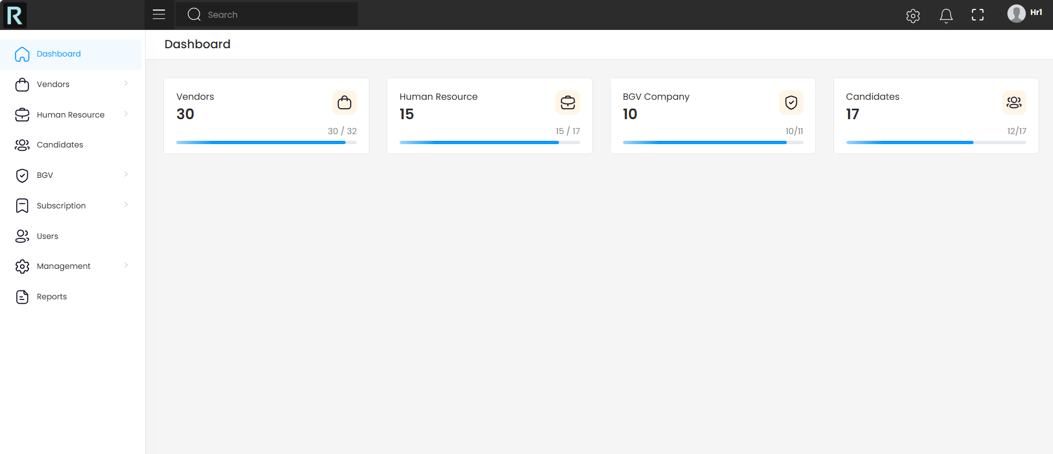
Admin Dashboard

Slide 13
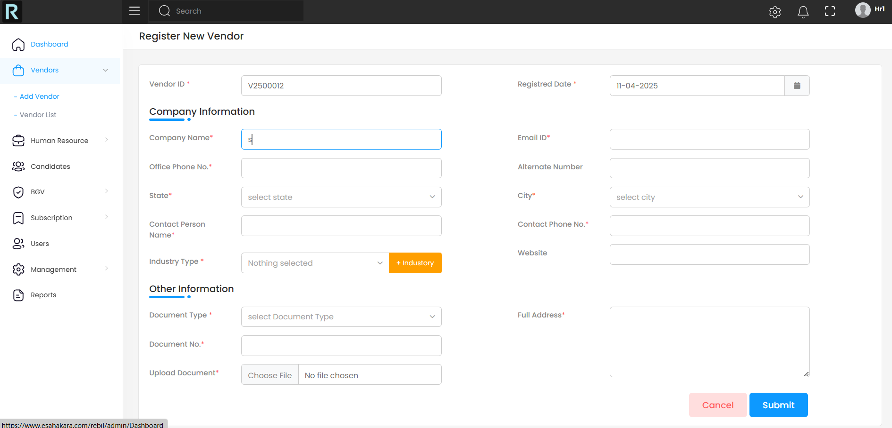
Vendor Registration

Slide 14
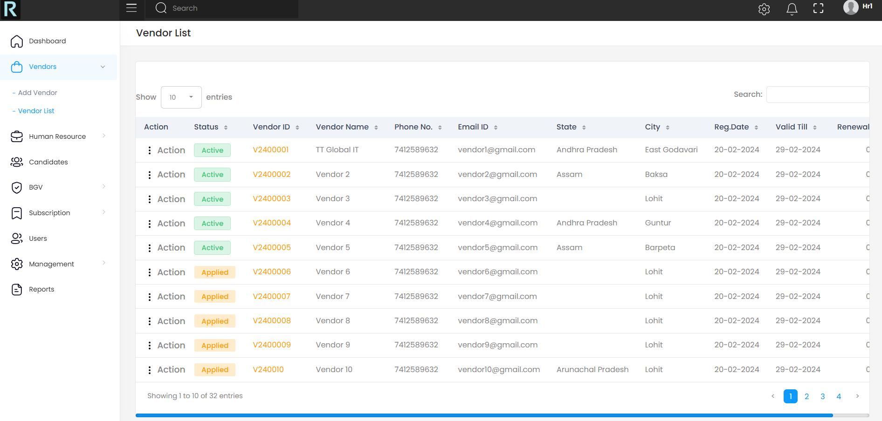
Vendor List

Slide 15
References
AI-Driven Recruitment and Selection: Enhanced HR Decision-Making with Accrued Benefits of Organizational Success - ResearchGate
Blockchain-based Authentication and Verification System for Academic Certificate using QR Code and Decentralized Applications - ResearchGate
Artificial Intelligence and Automation in Human Resource Development: Evidence from Emerging Economies - SAGE Journals
Leveraging AI for Effective Human Resource Management - SSRN
Artificial Intelligence in Human Resource: The Key to Successful Recruiting and Performance Management - ResearchGate
The Future of HR: The Role of AI-Powered Recruitment in Shaping Organizational Success - SCIRP
The Adoption of Artificial Intelligence in Human Resources Management and its Impact on Organizational Efficiency - ScienceDirect

Slide 16
Github Link
GitHub Repository:
https://github.com/Deepak-kumar-Singh-D/Rebil

Slide 17


